Slide 1
ECE 3130 Digital Electronics and Design
Lab 5 & Midterm project
Subtractors & Multiplier
Fall 2016

Slide 2
Lab#5 Objectives
Build and simulate a full subtractor.
Two XORs
Two Inverters
Two ANDs = NAND + Inverter
One OR = NOR + Inverter
Build and simulate a 4-bit subtractor.

Slide 3
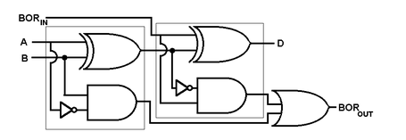
Full Subtractor
Truth Table
A | B | B_in | D | B_out
0 | 0 | 0 | 0 | 0
0 | 0 | 1 | 1 | 1
0 | 1 | 0 | 1 | 1
0 | 1 | 1 | 0 | 1
1 | 0 | 0 | 1 | 0
1 | 0 | 1 | 0 | 0
1 | 1 | 0 | 0 | 0
1 | 1 | 1 | 1 | 1
Implementation
Half Subtractor

Slide 4
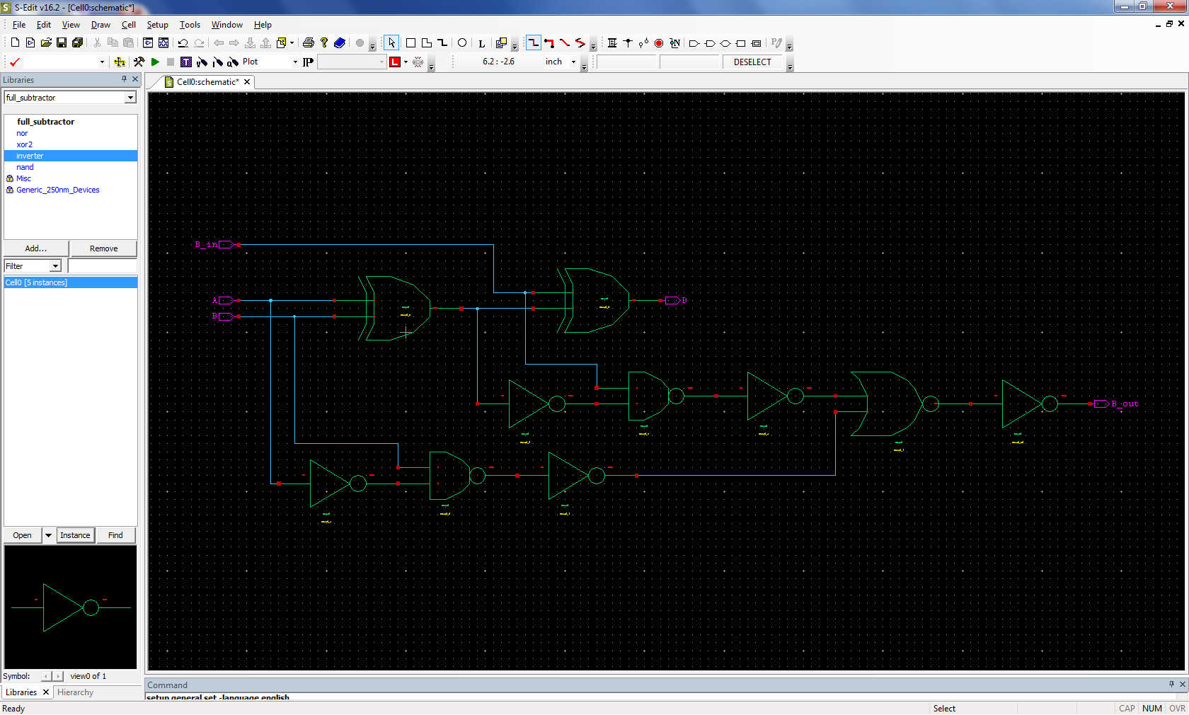
Full Subtractor - schematic

Slide 5
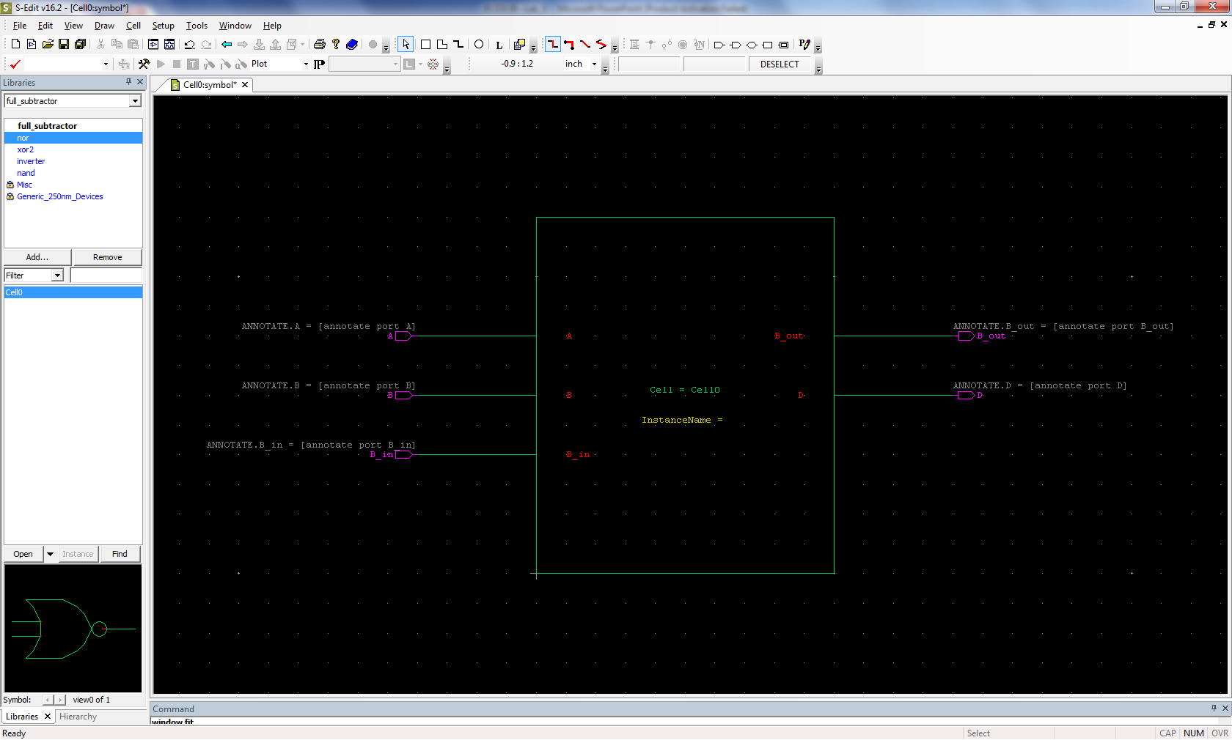
Full Subtractor – symbol

Slide 6
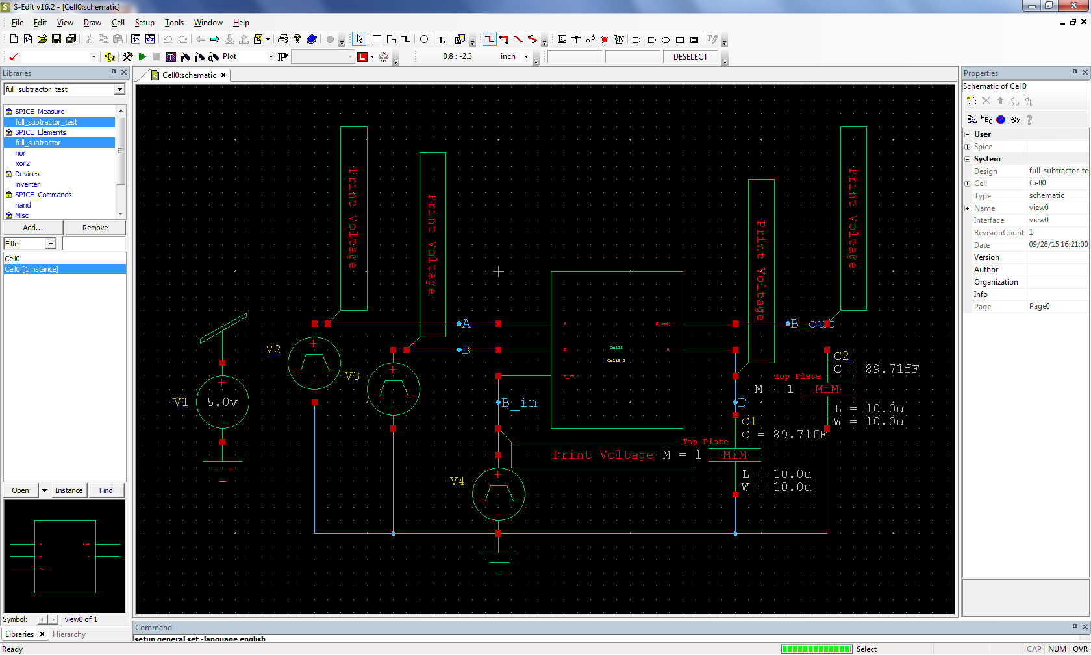
Full Subtractor – test circuit

Slide 7
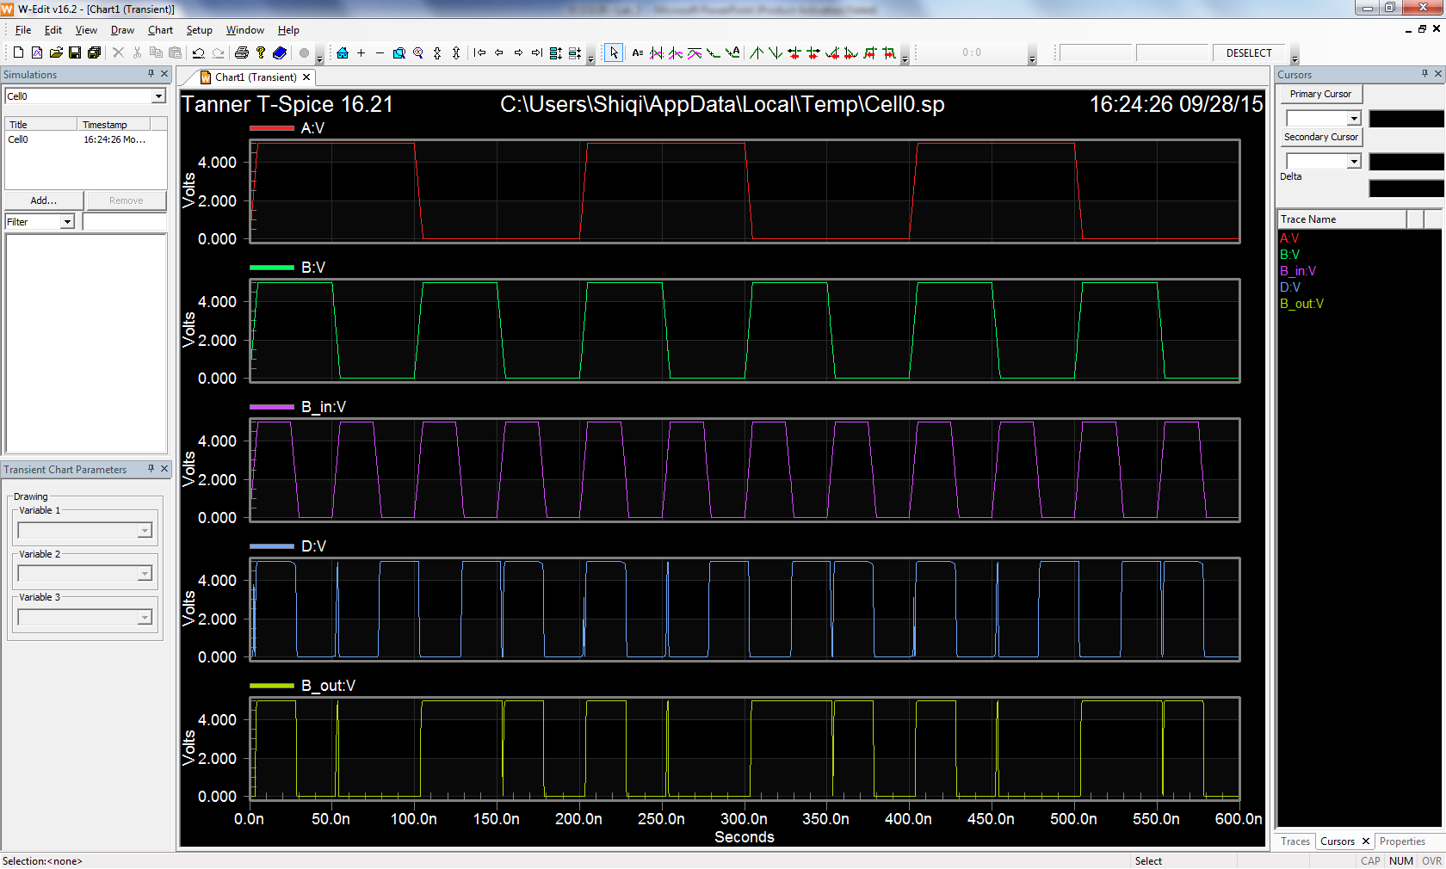
Full Subtractor – waveforms

Slide 8
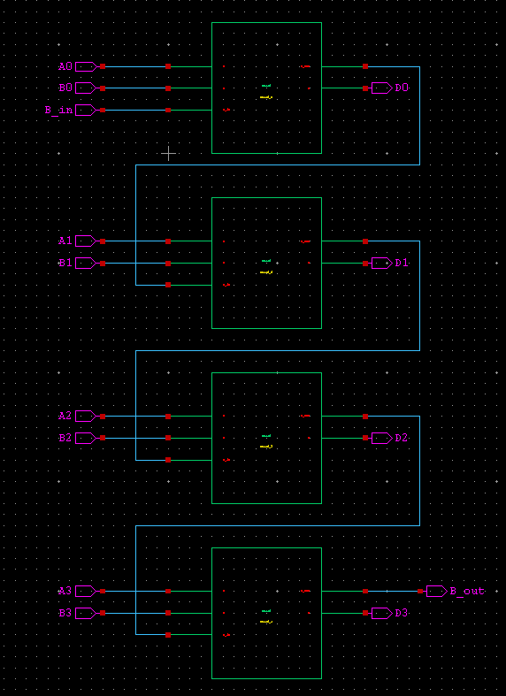
4-bit Subtractor - schematic

Slide 9
4-bit Subtractor – simulation
Test your 4-bit subtractor by setting up inputs:
A=0101, B=1101, Borrow_in=1
Simulate it and check the results, which should be:
D=0111, Borrow_out=1
P.S. A=0101 means A0=1, A1=0, A2=1, A3=0

Slide 10
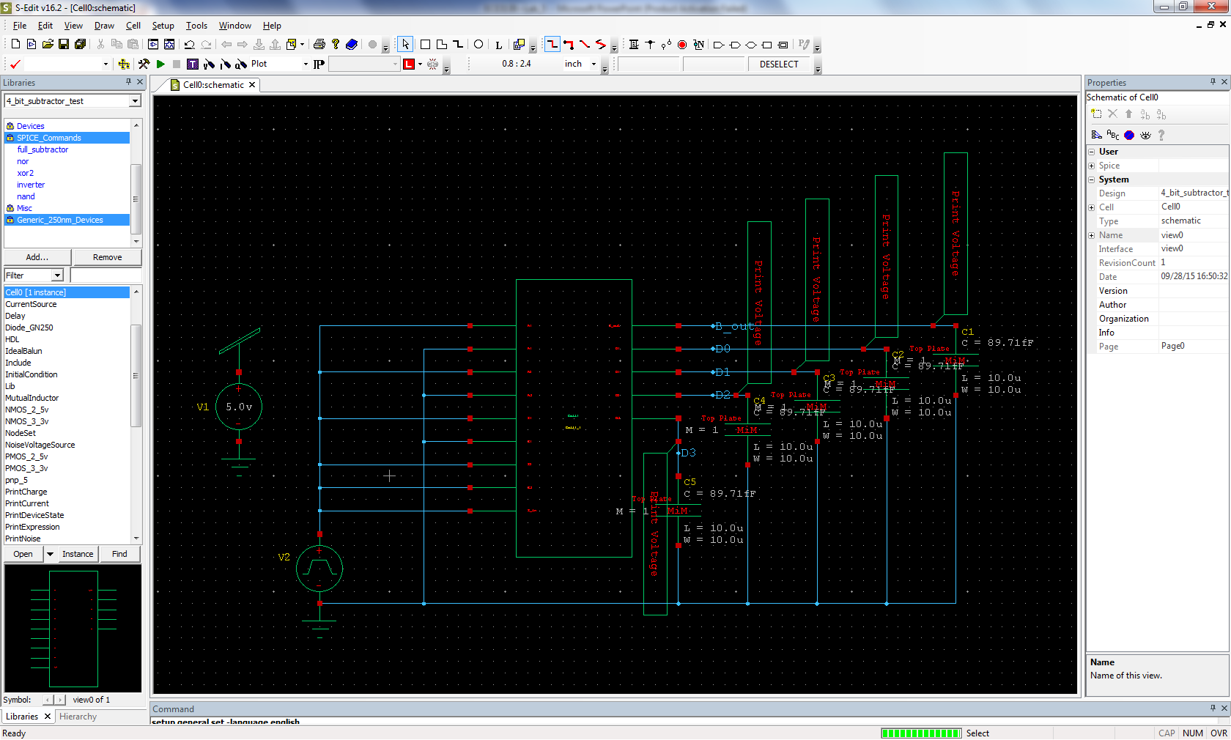
4-bit Subtractor – test circuit

Slide 11
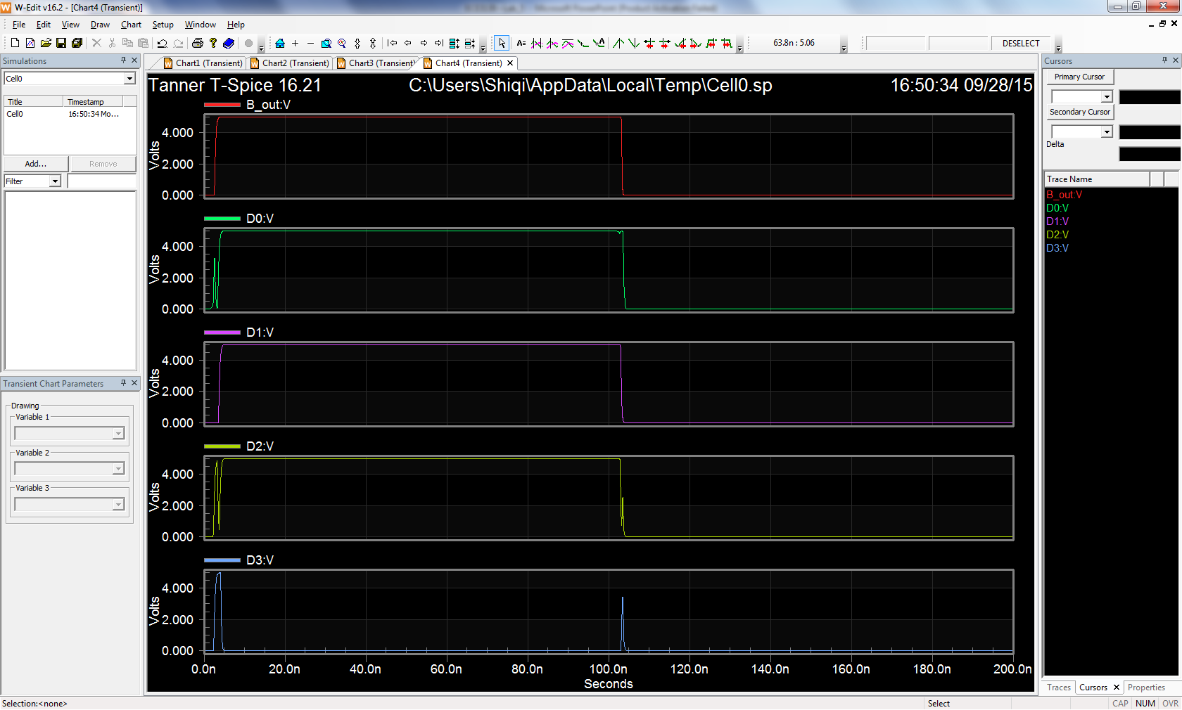
4-bit Subtractor – waveforms

Slide 12
Assignment
Build and simulate a Full Subtractor and a 4-bit Subtractor.
Attach all screenshots into one PDF file, including schematic, symbol, test circuit schematic, waveforms.

Slide 13
Midterm Project
Objective:
Build and simulate a 4-bit multiplier in Tanner tools.
Two 4-bit inputs & One 8-bit output.
Report should include multiplier schematic, test circuit schematic, simulation results(waveforms), explain how multiplier realizes the multiplication of binary numbers, analyze how your results prove the multiplier is working correctly.
Due date: October 14th.

Slide 14
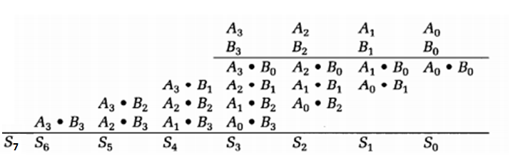
Calculation process of two 4-bit binary numbers’ multiplication.

